Slide 1


Optimal Scoring-Based Lag Selection for Time Series
A dissertation submitted in partial fulfilment of the requirements for the degree of
Master of Computational Finance
by
Shilin Zhang
Under the guidance of
Professor
Carmine Ventre
Department of Informatics
Kings College London
WC2R 2LS London
United Kingdom
August 2022
Notes:
Hello professors, This is Shilin Zhang,
and today I will introduce my dissertation project. Optimal Scoring-Based Lag Selection for Time Series
First of all, I would like to say thank you to my supervisor carmine for his guidance.

Slide 2
Overview
Introduction
Related Works
Proposed Method
Experiment & Result
Conclusion & Future Work
References

Slide 3
Introduction
Problem definition
Aims and objectives
Difficulties on solving the problem
Notes:
Time series data is a series of data points listed in time order and it is easy to access in our daily life.
In time series analysis, the primary goal is to use past values to predict future values.
So, it is essential to determine the proper number of past observations (lags) included as features.
And the number of the past observations here is the lag.
Optimal Lag selection is to find the lag to make prediction models or classification models reach the best performance
The aim of this study to find robust and fast method of optimal lag selection for different kinds of time series data and different models.
Difficulty on solving the problem is that the optimal lags vary from dataset to dataset or from model to model
And some methods may work well in one dataset but cannot perform well on others

Slide 4
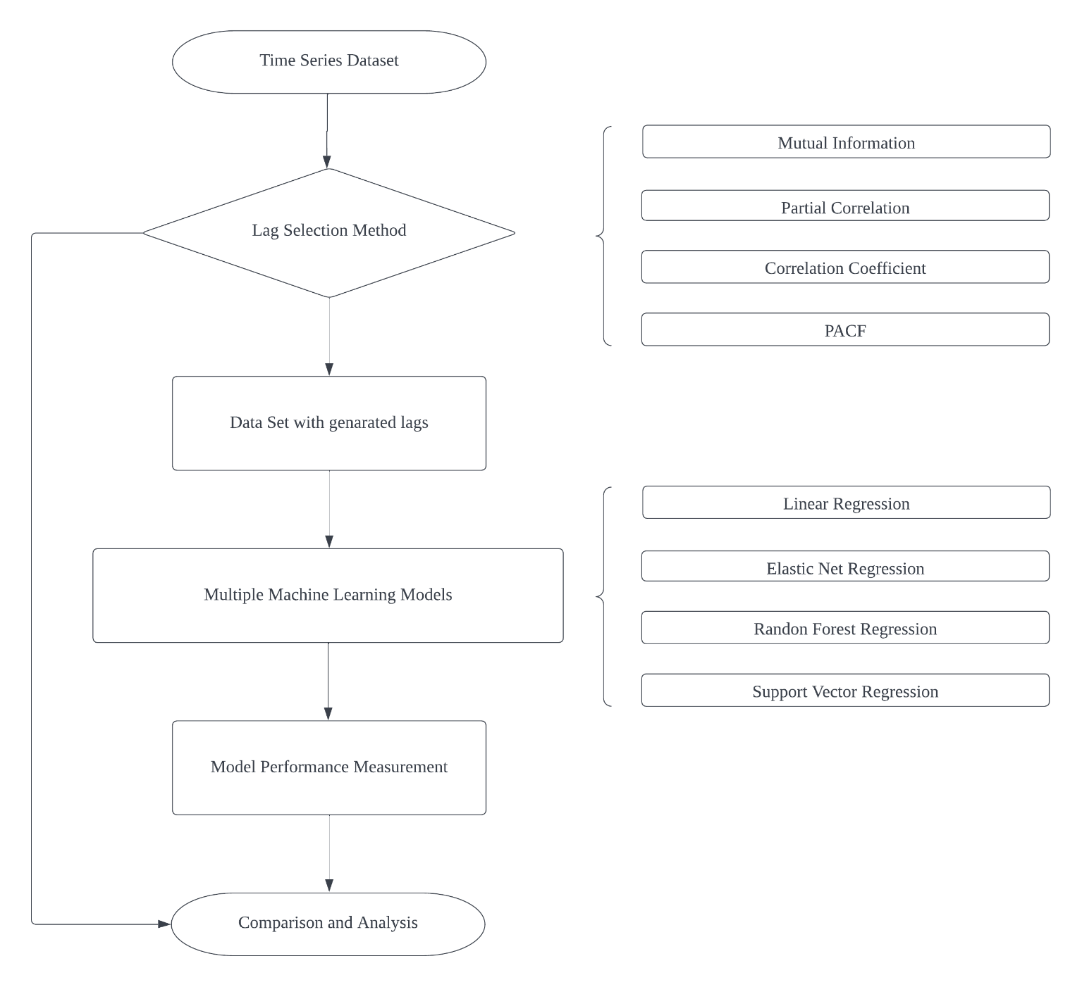
Notes:
Here is the overview of my study.
Dataset will be separated into training set and testing set
Training set will be put into the lag selection process
And then the dataset will be rearranged with the selected lags from the previous step.
Next, rearranged training sets are used to train the models
Rearranged testing sets are used to test the models and generate prediction model performance
Finally, there are comprisions and analysis based on the lag selection method and experiment results

Slide 5
Related Works
Lag Selection
Statistical Method [1]
Information Criterion [2]
Feature Selection
Heuristics method [3]
Greedy search method [4]
Regularization method [5]
Notes:
Traditional method
By using statistical test such as the likelihood ratio (LR), Lagrange Multiplier (LM), and Wald test [2].
Schwarz Information Criterion (SIC), the Hannan-Quinn Criterion (HQC), Akaike Information (AIC), Bayesian Information Criterion (BIC) and Autocorrelation Criterion (AC) [3] Mutual Information and Information Gain
There are some feature selection method
Types filter, wrapper, embedded methods
heuristics method [13] [14], greedy search method [15] and regularization method [16].
They are designed for the feature selection problem not the lag selection problem.

Slide 6
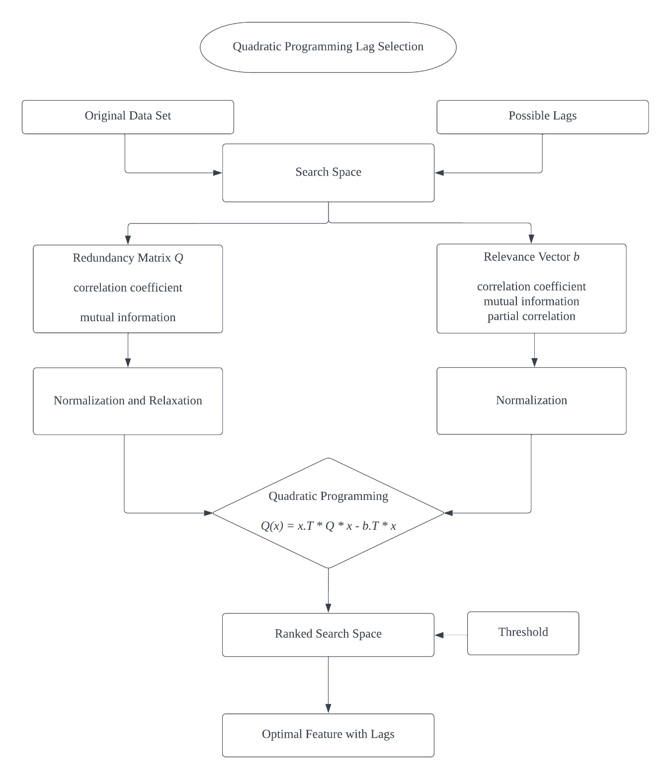
Notes:
Next part is the proposed method QPLS
The main idea of the method is to minimize the redundancy within features and maximize the
relevance between features and target.
So we need to construct the …
Min red – rel
by minimizing the formula, we could get feature importance scores x to all lagged features
In QPLS, the optimization problem is converted into the quadratic programming format and solved by a quadratic programming solver.
Based on the rank and threshold, we could decide to include or exclude features from the feature set.

Slide 7
Experiment Design
Lag Selection Method
Prediction Model
Performance Measurement
Dataset
Notes:
Genetic Algorithm Lag Selection the feature importance scores are in binary domain, redundancy part and relevance solved in sequence
Quadratic Programming Lag Selection the feature importance scores are in continuous domain, redundancy part and relevance solved simultaneously.
Partial Autocorrelation traditional statistical method to find lags base on PACF
Linear Regression Model
Elastic Net Regression Model
Random Forest Regression Model
Support Vector Regression Model
Redundancy: correlation coefficient and mutual information
Relevance: correlation coefficient, mutual information and partial correlation

Slide 8
Result
Notes:
For a specific model, the tables show that QPLS method is always the best compared
with the GALS method, PACF method and no selection benchmark on the data set from
2 to 5.
The number of lagged features selected by the QPLS is always less than
other methods with better or similar performance to the prediction model.
According to the results of all the data sets, the top two
criterion combinations are correlation redundancy with correlation relevance and mutual
information redundancy with correlation relevance. In different models over different
data sets, these two combinations always lead to a good performance of the prediction
model.
The proposed method is much fast and more robust compared with the GALS.
Based on the same objective function, the lag selection process is faster by using the
proposed method.

Slide 9
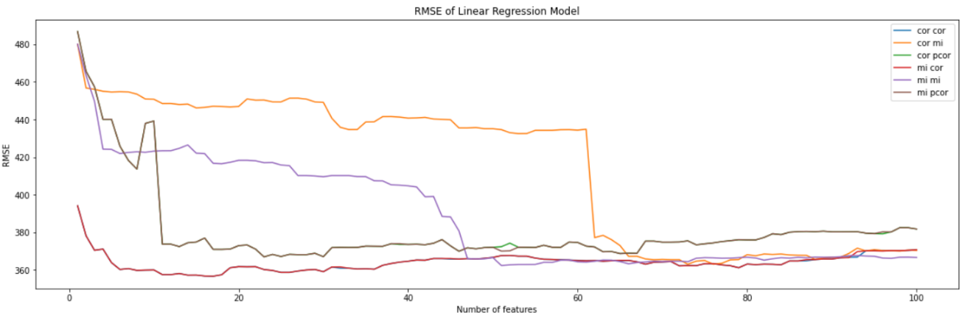
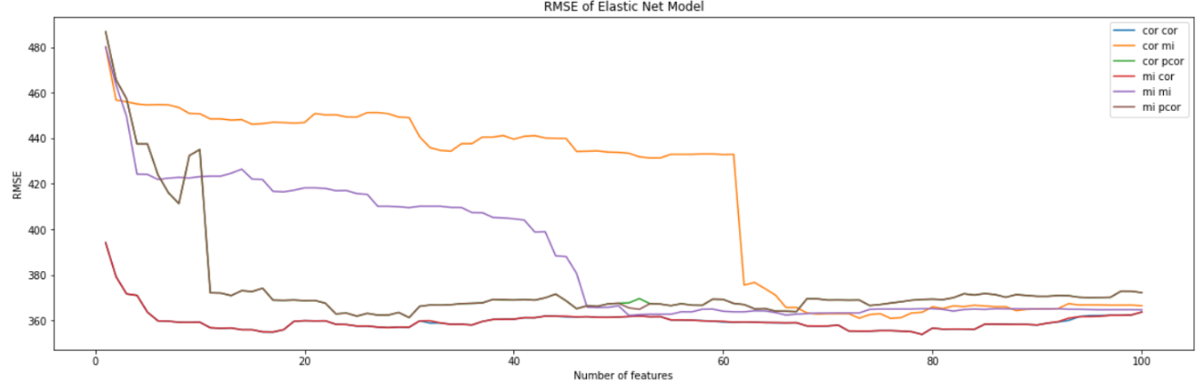
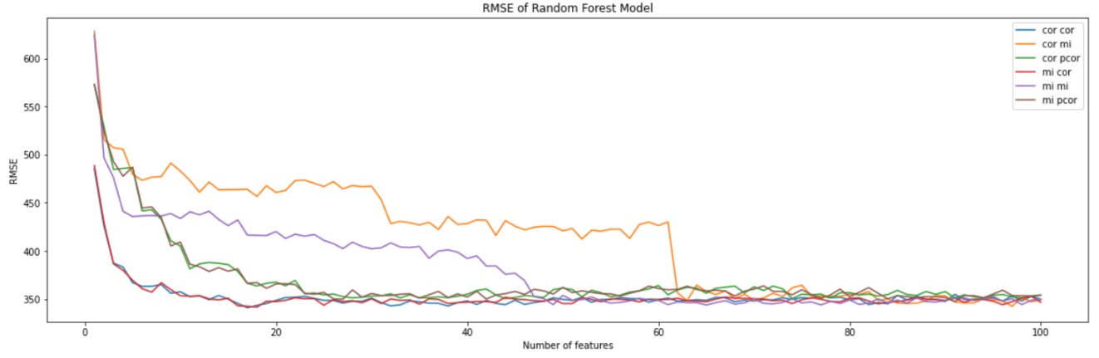
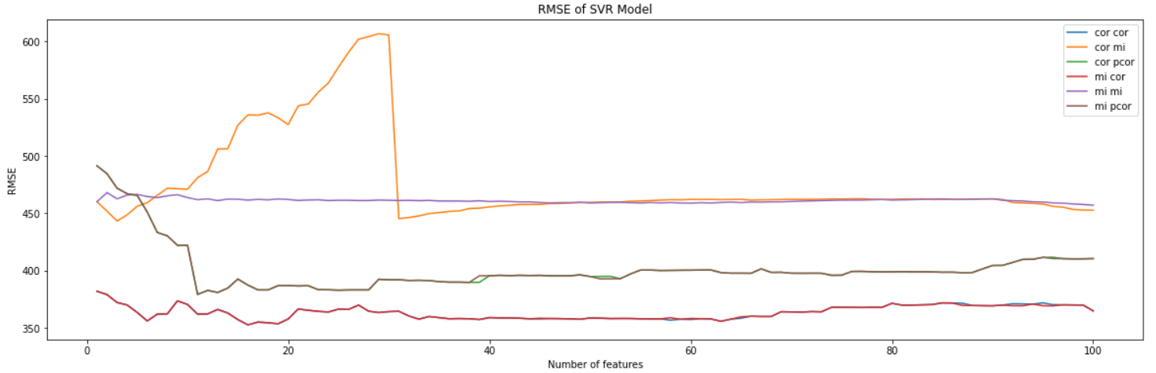
Result
Notes:
In the experiments, we use five datasets
Here is the result of different models on electricity dataset.
RMSE as a function of number of features in subset, in each figures, there are six criterion.
The figure shows the hyper parameter tuning of the method is the threshold.
After getting the feature importance score, we need to decide

Slide 10
Conclusion & Future Work
Conclusion
Improve Method Performance
Select the Best Criterion Combinations
Reduce Model Complexity
Future Work
Weight of the redundancy factor and the relevance factor
Automatic Hyperparameter Tuning
Notes:
The proposed method achieved the best results in 4 out of 5 data sets in regarding the RMSE performance measures.
The criteria combination that
correlation and correlation and
mutual information and correlation
could lead to good prediction performance.
the method could help us reduce the complexity of the regression models by selecting fewer features than other methods without decreasing the predictive performance of the model.
To keep the balance between the redundancy factor
and the relevance factor, we set the same weight on two parts.
But in the practical lag selection process,
there are different intrinsic information within the different data sets. Therefore,
the next step of this study is to find a method to set the weight of the redundancy factor
and the relevance factor dynamically based on the characteristic of different dataset.
To set the value of the hyperparameter automatically, we could refer to the idea of
the LASSO regression by adding the penalty.
And a specific number of the feature importance scores
could be set as zero through the calculation.

Slide 11
References
R. F. Engle, “Wald, likelihood ratio, and lagrange multiplier tests in econometrics,” Handbook of econometrics, vol. 2, pp. 775–826, 1984.
P. Stoica and Y. Selen, “Model-order selection: a review of information criterion rules,” IEEE Signal Processing Magazine, vol. 21, no. 4, pp. 36–47, 2004.
N. Zhong, J. Dong, and S. Ohsuga, “Using rough sets with heuristics for feature selection,” Journal of intelligent information systems, vol. 16, no. 3, pp. 199–214, 2001.
M. Sharma and P. Kaur, “A comprehensive analysis of nature-inspired metaheuristic techniques for feature selection problem,” Archives of Computational Methods in Engineering, vol. 28, no. 3, pp. 1103–1127, 2021.
Z. Cai and W. Zhu, “Feature selection for multi-label classification using neighborhoodpreservation,” IEEE/CAA Journal of Automatica Sinica, vol. 5, no. 1,pp. 320–330, 2017.
A. Y. Ng, “Feature selection, l 1 vs. l 2 regularization, and rotational invariance,” in Proceedings of the twenty-first international conference on Machine learning, p. 78,2004.

Slide 12
Thank You!!!

